Slide 1

Evaluating Regularization Methods Effect on Transfer Learning Performance
By: Nufar Cohen, Ori Fridman

Slide 2

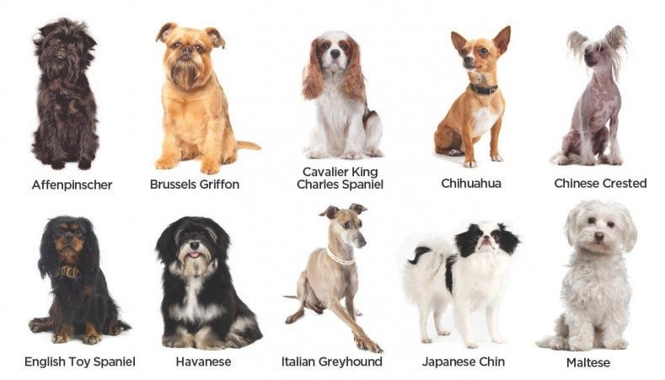
Motivation
Traditional classifiers use Cross Entropy loss
Not encouraged to distinguish between samples from the same class
Might learn minimum features necessary for classifying
Robust Transfer Learning requires rich representations
Variety of downstream tasks
fine-grained details (example)
SSL Methods aim to learn meaningful representations
So Why not incorporate it in the loss?

Slide 3

Project’s Goals
We will use the next Loss Function –
$$𝓛=𝓛_{CE}+λ⋅R_{Regularization}$$
With 3 different regularizations methods from SSL domain
Compare transfer learning accuracy
With and without added regularization
Various datasets trimmed to different sizes

Slide 4
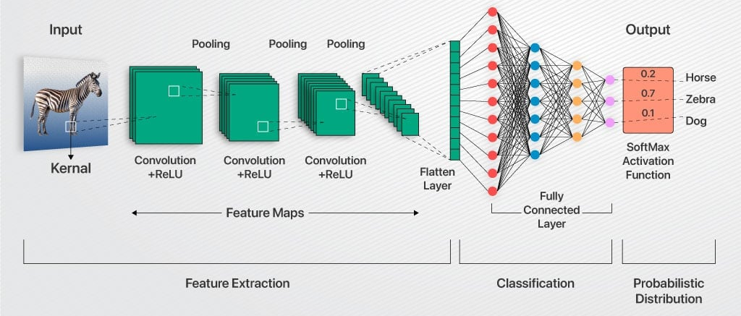
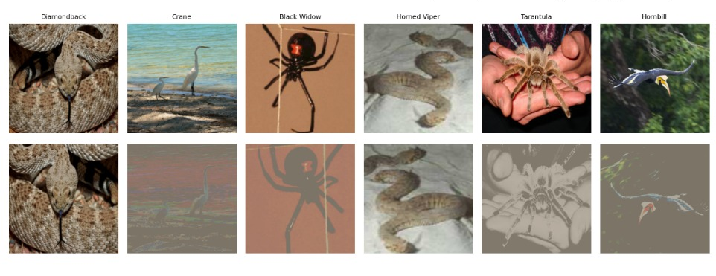


Our Method
Train From Scratch
Use Pretrained Weights
Added Regularization
Train Resnet-50 on ImageNet-100
With regularization on latent CNN’s Features (pre-FC)
augmentations
Hyperparameter tune regularization weight $λ$ (20 epochs)
Full training (100 epochs)
128 batches, SGD optimizer 0.01 LR, CosineAnnealingLR scheduler
Perform Transfer Learning
Use model’s backbone (Frozen)
Train only FC layer using CE loss
“Features”
$$𝓛=𝓛_{CE}+λ⋅R_{Regularization}$$

Slide 5
Hyperparameters used
For both Pretraining and Transfer Learning tasks:
SGD optimizer
Learning Rate: 0.01, Momentum: 0.9, Weight Decay: 1e-4
Cosine Annealing scheduler
Batch Sizes
Pretraining: 128
Transfer Learning: 32
Epochs
Pretraining: 100
Transfer Learning: 50

Slide 6
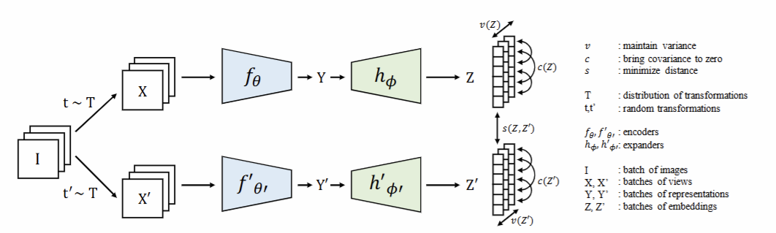

Regularization Techniques Examined
VICReg (Variance, Invariance, Covariance)
Variance – maintain each component Variance > T
Invariance – force similar features vectors for augmentation pair
Covariance – decorrelate features components ($Cov →0$)
Notes:
All regularizations works per batch
variance - of each embedding variable over a batch is maintained above a threshold
covariance between pairs of embedding variables over a batch are attracted to zero

Slide 7
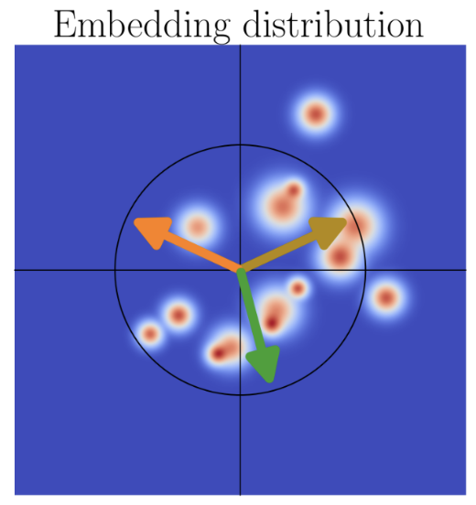
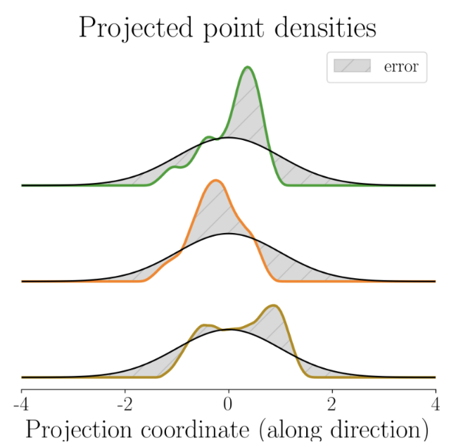
Regularization Techniques Examined
SIGReg –
Maintains Isotropic Gaussian Distribution of Features
*in theory – Optimal on all downstream tasks (for worst-case)
Works by comparing characteristic functions
Notes:
SIGREG – Projects features on random M dimensional space per batch for complexity reasons.
Beating the "Curse of Dimensionality“.
By projecting onto random different spaces, we essentially do consider all dimensions.

Slide 8
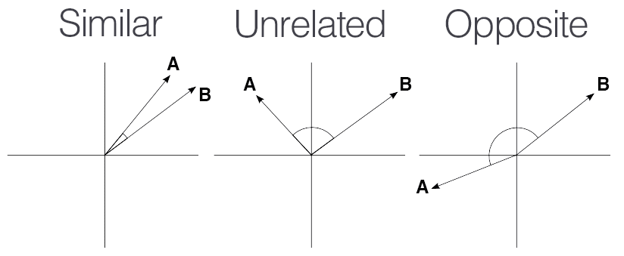



Regularization Techniques Examined
Cosine Similarity
Encourages orthogonality between features vectors of different samples in the batch
Avoids representations collapse
$$sim(a,b) ≈1$$
$$sim(a,b) ≈0$$
$$sim\left(a,b\right)≈−1$$
$$R=Σ_{a,b}si{m(a,b)}^{2}$$

Slide 9
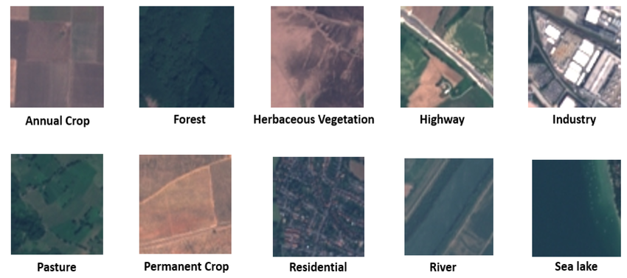
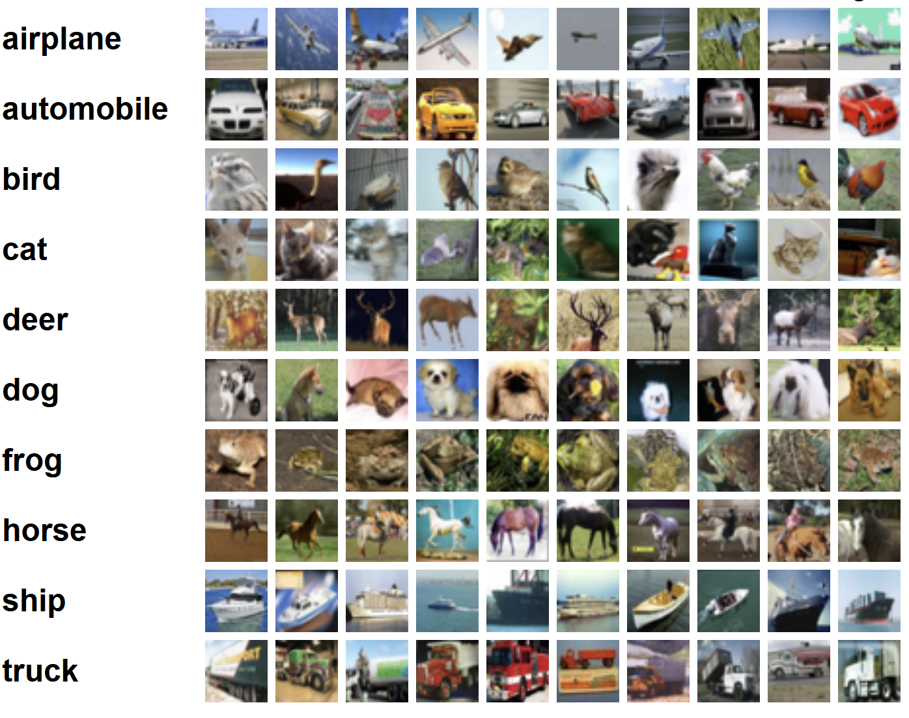
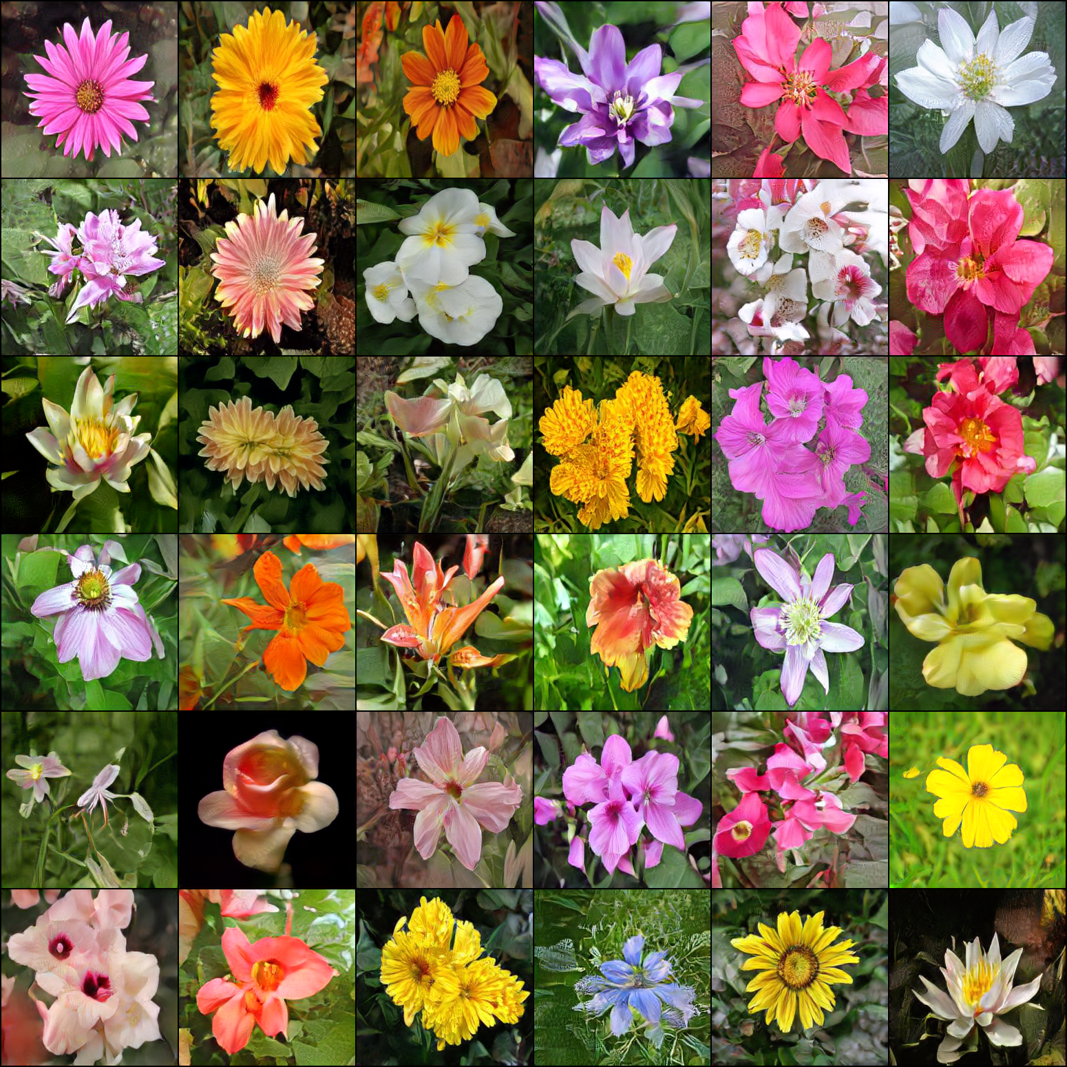
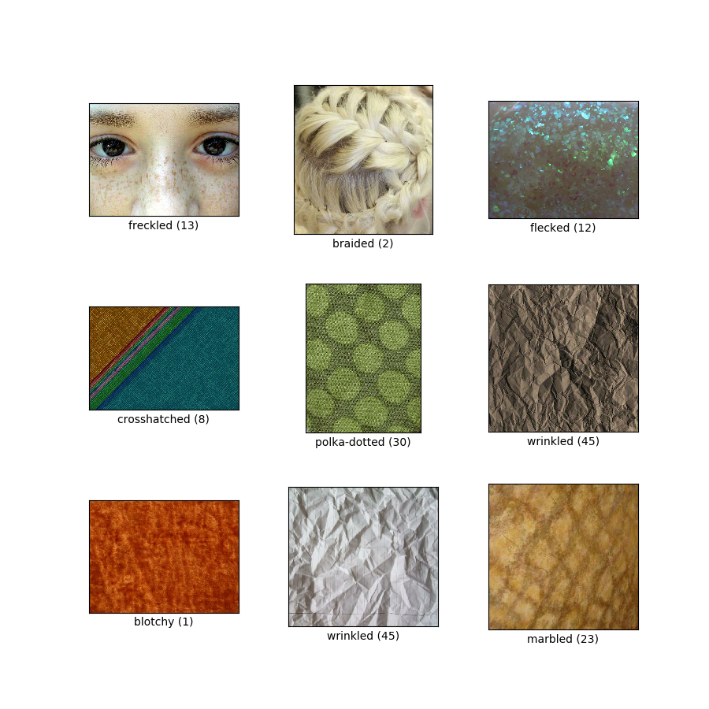
Transfer Learning Datasets
Benchmark
cifar-10
Fine-Grained Details
Flowers-102
Domain Shift
EuroSat (satellite images)
DTD (Describable Textures)
Notes:
EuroSat – 10 classes
DTD – 47 classes

Slide 10
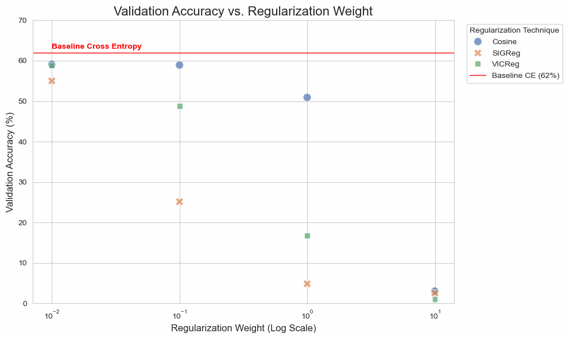
Results and Conclusions
Regularization Weight Hyperparameter Tuning
Chosen regularization weights
Notes:
Hyperparameter 20 epochs

Slide 11
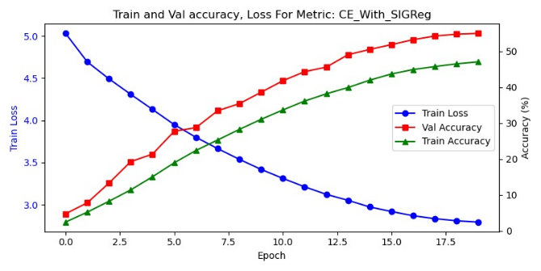
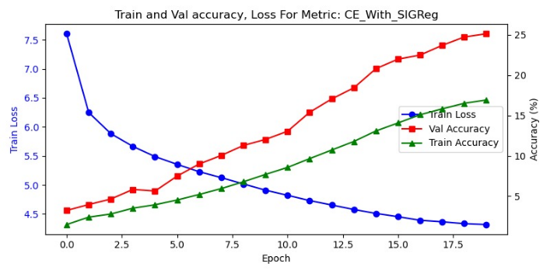
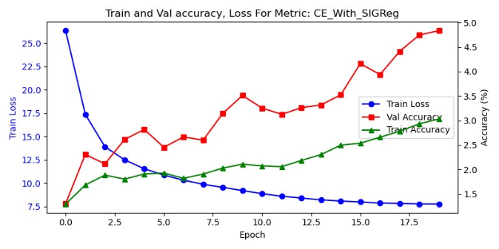
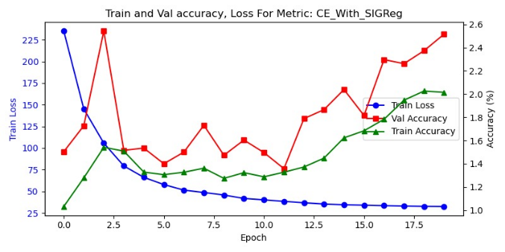




Regularization Weights Tuning - SIGReg
$$λ=0.01$$
$$λ=0.1$$
$$λ=1$$
$$λ=10$$

Slide 12
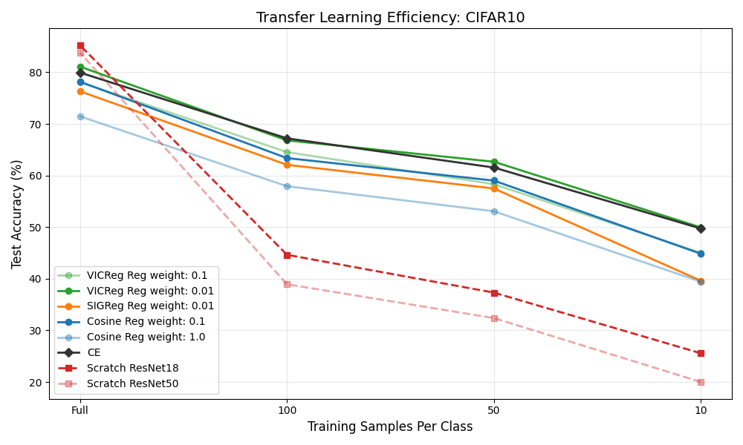
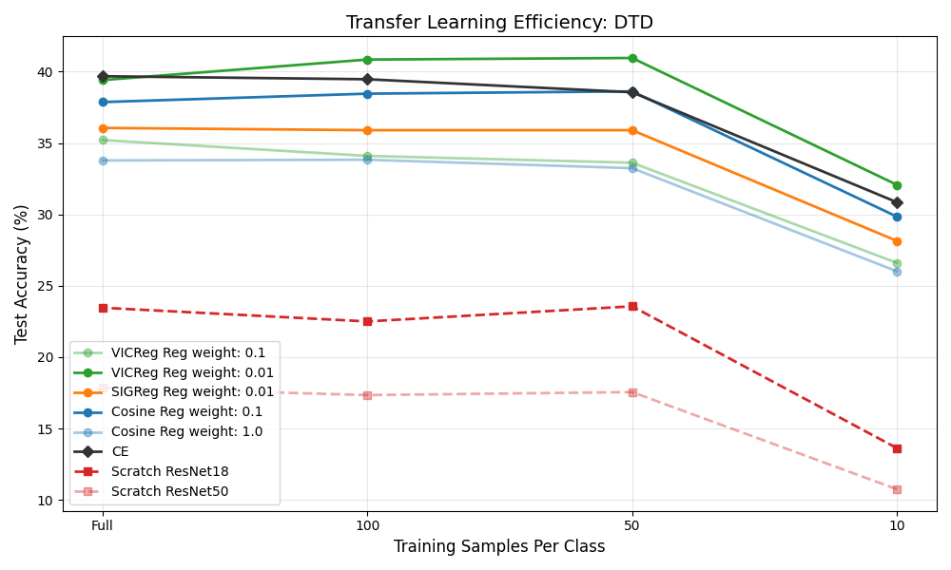
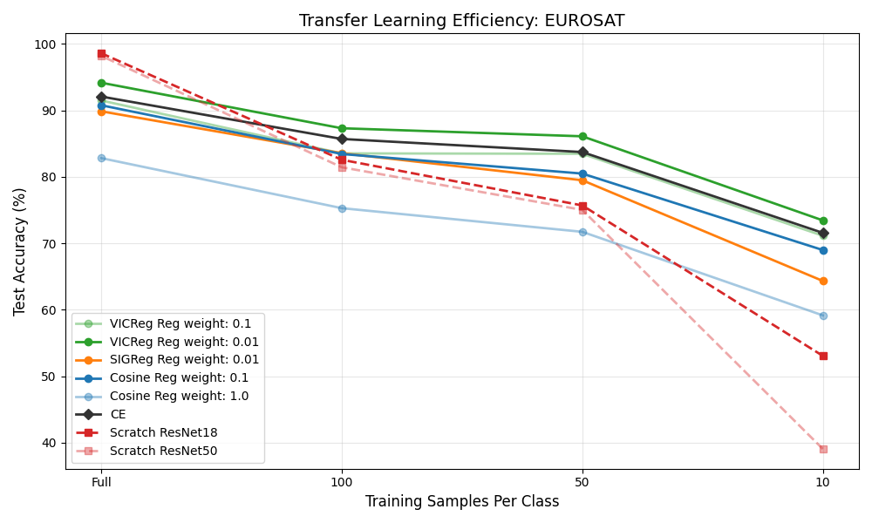
Results and Conclusions
Pretraining
Surprisingly, most regularizations improved test accuracy
Transfer Learning
More effective as training dataset size decrease
Only VICReg constantly surpass CE loss
Added SSL regularization on pretrain can improve performance
Full Training Test Performance (100 epochs)
Dataset | CE | Cosine |  | SIGReg | VICReg
Regularization weight | - | 0.1 | 1 | 0.01 | 0.01 | 0.1
Test accuracy | 71.28 | 73.42 | 75.36 | 74.6 | 70.14 | 61.48
Flowers102 Transfer learning results
Dataset | CE | Cosine |  | SIGReg | VICReg |  | ResNet18 | ResNet50
 |  |  |  |  |  |  | From | From
 |  |  |  |  |  |  | Scratch | Scratch
Regularization weight | - | 0.1 | 1 | 0.01 | 0.01 | 0.1 | - | -
Test accuracy | 58.82 | 56.7 | 40.7 | 46.6 | 60 | 53.1 | 34.98 | 29.22

Slide 13
Future Work
Compare result over different SSL regularization techniques & architectures & datasets
Examine slightly harsher regularizations
That slightly diminish test accuracy

Slide 14
Thank You For Listening

